Slide 2

Angular Data Validation

Slide 3
Agenda

Slide 4
Angular – Form Validation
Improve overall data quality by validating user input for accuracy and completeness.
This shows how to validate user input in the UI and display useful validation messages using both reactive and template-driven forms. It assumes some basic knowledge of the two forms modules.
A validator is a function that checks the instance of FormControl, FormGroup or a FormArray and returns a list of errors. If the Validator returns a null means that validation has passed.

Slide 5
Angular – Form Validation
Built-in Validators
The Angular Forms Module provides a few built-in validators to help us to validate the form. They are listed below.
Required validator
Min length Validator
Max length Validator
Pattern Validator
Email Validator

Slide 6
Angular – Example Reactive Form Validation
How to add validator
We configure the validators as the second and third argument to the FormControl, FormGroup or FormArray.
The second argument is a collection of sync validators and the third argument is a collection of an async validators.
sync validators runs validations and returns immediately. They either return a list of errors or null if no errors found.
async validators returns a Promise or Observable. They either return a list of errors or null if no errors are found.

Slide 7
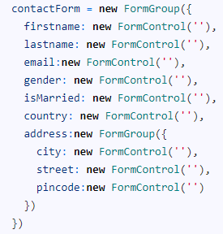
Angular – Example Reactive Form Validation
Model
Here is the contactForm

Slide 8
Angular – Example Reactive Form Validation
Disabling the Browser validation
First, we need to disable browser validator by adding the novalidate attribute to the <form> element as shown below. If this attribute is present then the form is not validated by the built-in HTML5 validation when submitted.

Slide 9
Angular – Example Reactive Form Validation
Adding in Built-in validators
Required Validator
The required validator is a sync validator, which returns true only if the formcontrol has a non-empty value entered. The second argument of the FormControl takes the Sync Validator.
Minlength Validator
Minlength validator requires the control value must not have less number of characters than the value specified in the validator.
For Example, minlength validator ensures that the firstname value has at least 10 characters.

Slide 10
Angular – Example Reactive Form Validation
Maxlength Validator
This Validator requires that the number of characters must not exceed the value specified in the validator.
Pattern Validator
This Validator requires that the control value must match the regex pattern provided in the attribute. For example, the pattern ^[a-zA-Z]+$ ensures that the only letters are allowed (even spaces are not allowed). Let us apply this pattern to the lastName.

Slide 11
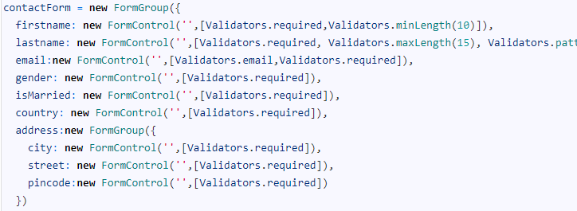
Angular – Example Reactive Form Validation
Email Validator
This Validator requires that the control value must be a valid email address. We apply this to the email field.
After adding all the validators, our final contactForm will look like this.

Slide 12
Angular – Example Reactive Form Validation
Disable Submit Button
We have successfully added the validators. Now, we need to disable the submit button if our form is not valid.
The Angular Forms API exposes the state of the forms through the FormGroup, FormControl & FormArray instances. The FormGroup control has a property valid, which is set to true if all of its child controls are valid.
The contactForm represents the top-level FormGroup. We use it to set the disabled attribute of the submit button.

Slide 13
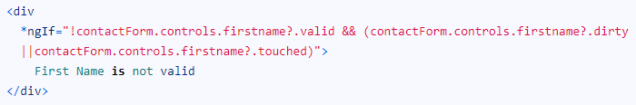
Angular – Example Reactive Form Validation
Displaying the Validation/Error messages
We need to provide a short and meaningful error message to the user. We do that by using the error object returned by the FormControl instance
Every form element has a FormControl instance associated with it. It exposes the state of form element like valid, dirty, touched etc.
There are two ways in which we can get the reference to the FormControl.
One way is to use the contactForm variable. We can use contactForm.controls.firstname.valid to find out if the firstname is valid.

Slide 14


Angular – Example Reactive Form Validation
The other way to is to define getter function for each FormControl instance in the component class.
and then use it in the template as follows

Slide 15
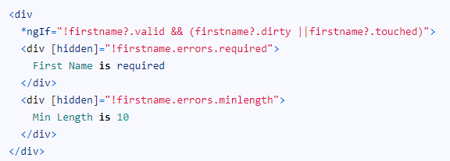
Angular – Example Reactive Form Validation
Dirty: A control is dirty if the user has changed the value in the UI.
Touched: A control is touched if the user has triggered a blur event on it.
Error Message
The error message “First Name is not valid ” is not helpful. The firstname has two validators. required and minlength
Any errors generated by the failing validation is updated in the errors object. The errors object returns the error object or null if there are no errors.

Slide 16
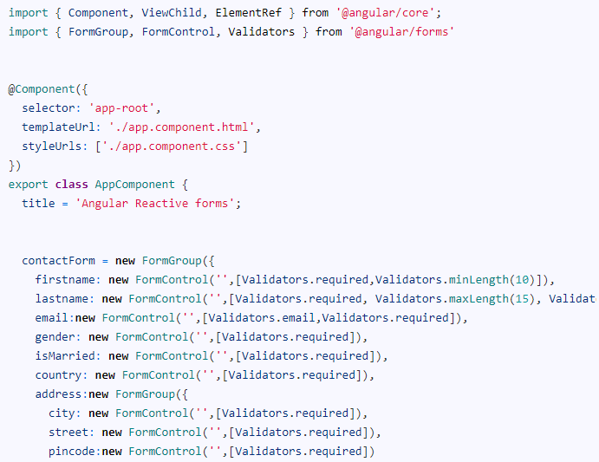
Angular – Example Reactive Form Validation
Final Code

Slide 17
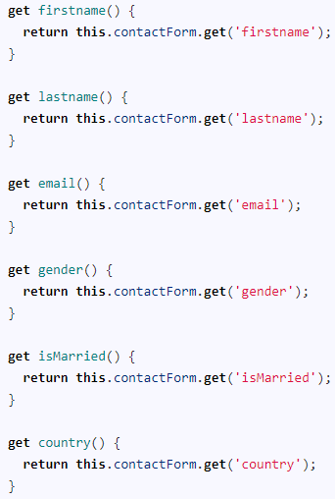
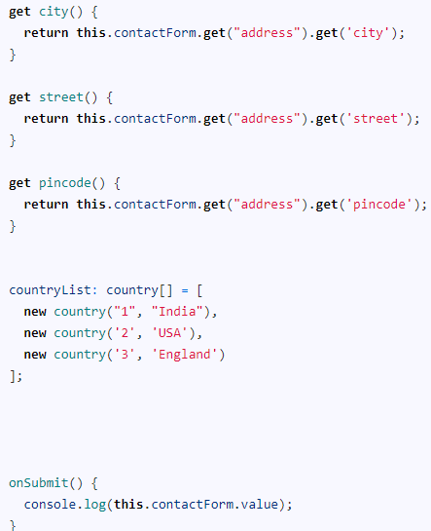
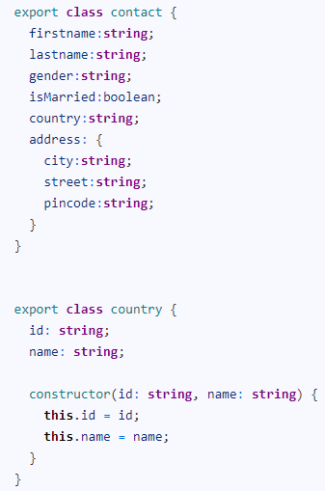
Angular – Example Reactive Form Validation

Slide 18

Angular – Custom Validator in Reactive Forms
How to Build Custom Validator
It is a function, which must implement ValidatorFn Interface.
ValidatorFn
The ValidatorFn is an Interface, which defines the signature of the Validator function.
The function takes the AbstractControl. This is the base class for FormControl, FormGroup, and FormArray. The validator function must return a list of errors i.e ValidationErrors or null if the validation has passed

Slide 19
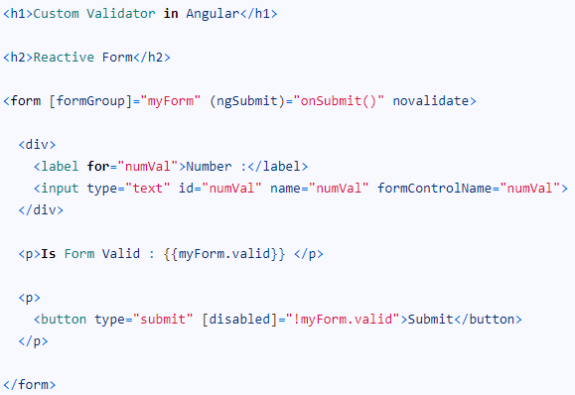
Angular – Example Custom Validator in Reactive Forms
Create a new angular application. Add the following code in app.component.html.
Our example app has numVal form field. We want it to be greater than 10.

Slide 20
Angular – Example Custom Validator in Reactive Forms
Angular does not have any built-in validator for that. Hence let us build a custom Validator gte
Create a new file gte.validator.ts under the app folder.
First, import the AbstractControl and ValidationErrors from the @angular/forms
The validator function must adhere to the ValidatorFn Interface. It should receive the AbstractControl as its parameter. It can be FormControl, FormGroup or FormArray.
The function must validate the control value and return ValidationErrors if any errors are found otherwise null.

Slide 21
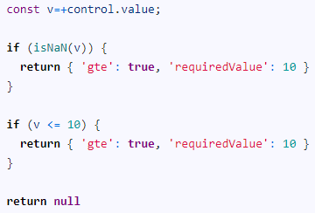
Angular – Example Custom Validator in Reactive Forms
The ValidationErrors is a key-value pair object of type [key: string]: any and it defines the broken rule. The key is the string and should contain the name of the broken rule. The value can be anything, but usually set to true.
The validation logic is very simple. Check if the value of the control is a number using the isNaN method. Also, check if the value is less than or equal to 10. If both the rules are valid and then return null

Slide 22
Angular – Example Custom Validator in Reactive Forms
If the validation fails then return the ValidationErrors. You can use anything for the key, but it is advisable to use the name of the validator i.e gte as the key. Also, assign true as value. You can as well assign a string value.
We can return more than one key-value pair as shown in the above example. The second key requiredValue returns the value 10. We use this in the template to show the error message.

Slide 23


Angular – Example Custom Validator in Reactive Forms
Using the Custom Validator
To use this validator first, import it in the component class.
Add the validator to the Validator collection of the FormControl as shown below.

Slide 24
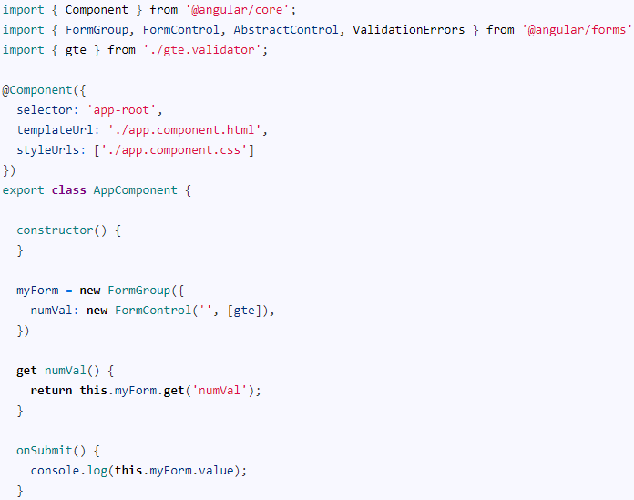
Angular – Example Custom Validator in Reactive Forms
The complete app.component.ts is shown below.

Slide 25
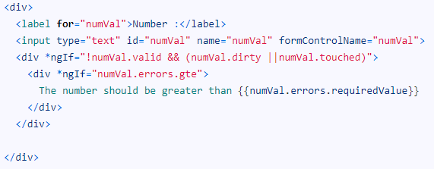
Angular – Example Custom Validator in Reactive Forms
Accessing the Errors from Custom Validator
Validators return ValidationErrors. They are added to the control’s errors collection of the control. The valid property of the control is set to false.
Hence, we check if the valid property. We also check the dirty and touched property. Because we do not want to display the error message when the form is displayed for the first time.

Slide 26

Angular – Example Custom Validator in Reactive Forms
We check if the gte is true and display the error message. Note that gte is the name of the key we used while creating the validator.
We also make use of the requiredValue to show a meaningful message to the user.
Now, we have successfully built a custom validator in reactive forms.

Slide 27
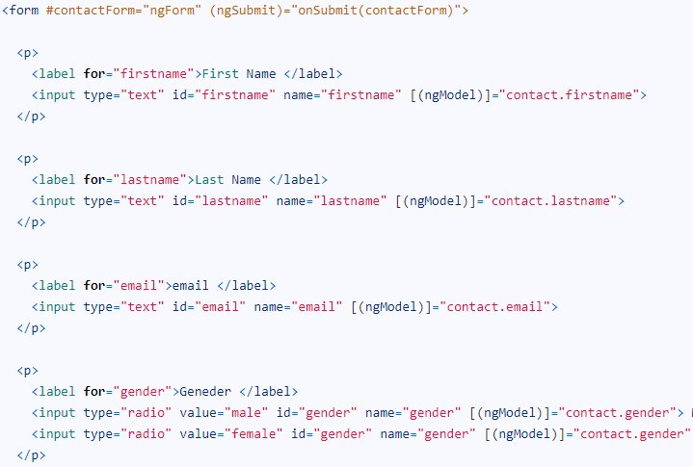
Angular – Example Template Driven Form Validation
Template
Consider the following template-driven form. It has firstname, lastname, email, gender & istoc form fields.

Slide 28
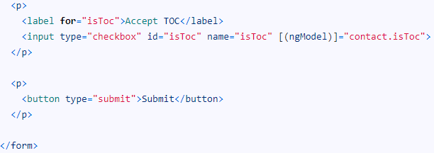
Angular – Example Template Driven Form Validation

Slide 29
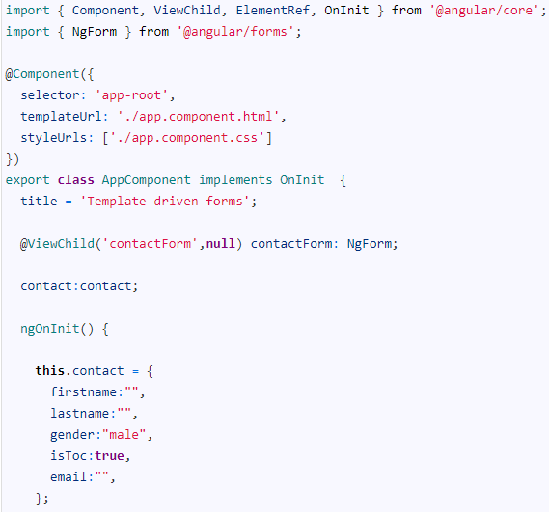
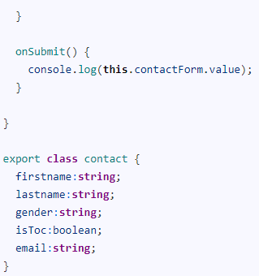
Angular – Example Template Driven Form Validation
Component Class

Slide 30
Angular – Example Template Driven Form Validation
Disabling the Browser validation
First, we need to disable browser validator interfering with the Angular validator. To do that we need to add novalidate attribute on <form> element as shown below.
Built-in Validators
The Built-in validators use the HTML5 validation attributes like required, minlength, maxlength & pattern. Angular interprets these validation attributes and add the validator functions to FormControl instance.

Slide 31
Angular – Example Template Driven Form Validation
Required Validation
The required validator returns true only if the form control has non-empty value entered. Let us add this validator to all fields.
Minlength Validation
This Validator requires the control value must not have less number of characters than the value specified in the validator.
For Example, minlength validator ensures that the firstname value has at least 10 characters.

Slide 32
Angular – Example Template Driven Form Validation
Maxlength Validation
This Validator requires that the number of characters must not exceed the value of the attribute.
Pattern Validation
This Validator requires that the control value must match the regex pattern provided in the attribute. For example, the pattern ^[a-zA-Z]+$ ensures that the only letters are allowed (even spaces are not allowed). Let us apply this pattern to the lastName.

Slide 33
Angular – Example Template Driven Form Validation
Email Validation
This Validator requires that the control value must be a valid email address. We apply this to the email field.
Disable Submit button
Now, we have successfully added the validators. We will notice that the click submit button still submits the form.
Angular forms module keep track of the state of our form and each of its form elements. These states are exposed to the user through FormGroup, FormArray & FormControl objects.

Slide 34
Angular – Example Template Driven Form Validation
We get the reference to the top-level FormGroup instance by creating a template variable and bind it to ngForm. We have already done it when we had added the #contactForm="ngForm" in our form tag.
The FormGroup has a valid property, which is set to true if all of its child controls are valid. We use it to set the disabled attribute of the submit button.
So long as contactForm.valid remains false, the submit button remains disabled.

Slide 35
Angular – Example Template Driven Form Validation
Displaying the Validation/Error messages
Angular creates a FormControl for each and every field, which has ngModel directive applied. The FormControl exposes the state of form element like valid, dirty, touched, etc.
There are two ways in which we can get the reference to the FormControl.
One way is to use the contactForm variable. We can use the contactForm.controls.firstname.valid to find out if the firstname is valid.
The other way is to create a new local variable for each FormControl For Example, the following firstname="ngModel" creates the firstname variable with the FormControl instance.

Slide 36
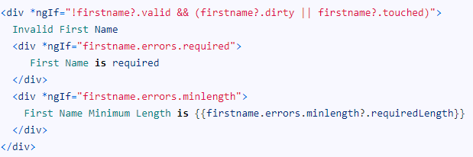
Angular – Example Template Driven Form Validation
Error Message
The error message “Invalid First Name” is not helpful. The firstname has two validators. required and minlength
Any errors generated by the failing validation is updated in the errors object. The errors object returns the error object or null if there are no errors.

Slide 37
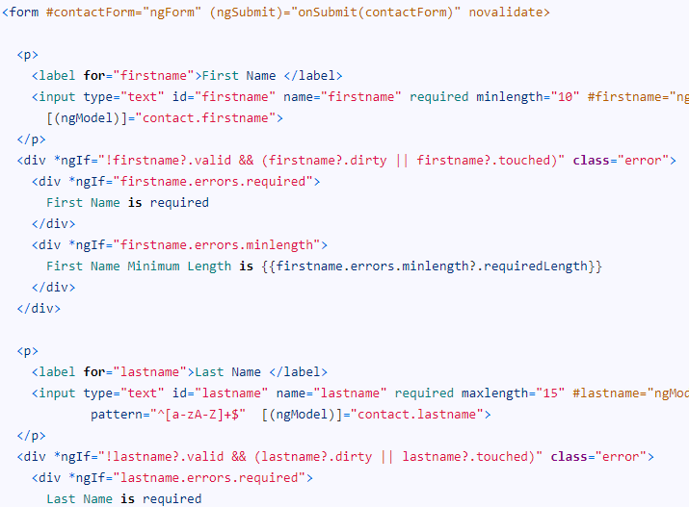
Angular – Example Template Driven Form Validation
Final Template

Slide 38
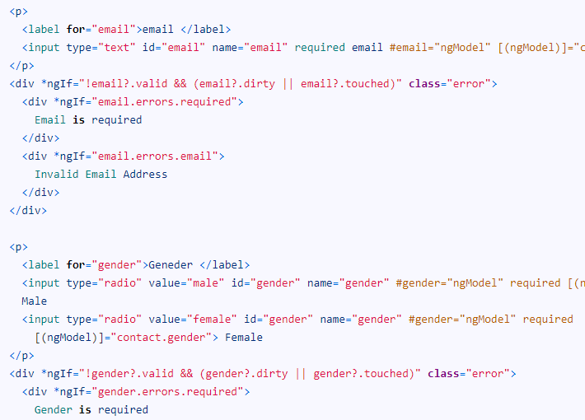
Angular – Example Template Driven Form Validation

Slide 39
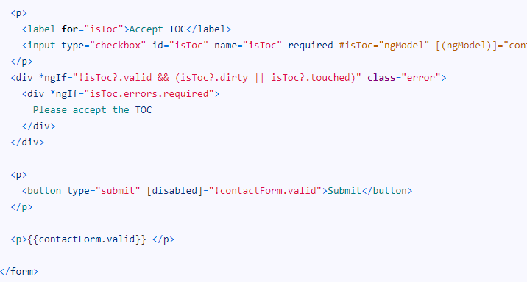
Angular – Example Template Driven Form Validation

Slide 40

Angular - Custom Validator in Template Driven Form
How to build custom validator in Template Driven Form
Building a Validator in template-driven forms is similar to building an Angular directive. The directive must implement the Validator interface.
Validator Interfaces
The directive must implement the validate function. Notice that the validate function has the same signature as the ValidatorFn Interface. Whenever the Validator directive is invoked angular looks for the validate method and invokes it.

Slide 41

Angular - Custom Validator in Template Driven Form
Validate Function
A Validator is just a function, which must implement ValidatorFn Interface.
The function takes the AbstractControl. This is the base class for FormControl, FormGroup, and FormArray. The validator function must return a list of errors i.e ValidationErrors or null if the validation has passed.

Slide 42
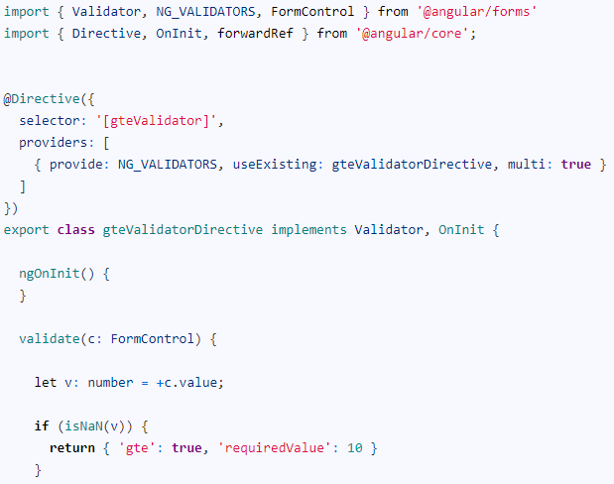
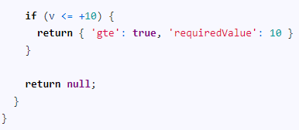
Angular - Example Custom Validator in Template Driven Form
Create the gte.validator.ts

Slide 43
Angular - Example Custom Validator in Template Driven Form
We decorate the directive using @Directive decorator.
We use the directive as an attribute in the HTML template. The attribute needs a name or selector. We assign the name as gteValidator in the selector metadata section of the directive decorator.
The Angular knows nothing about the Validation capabilities of our directive. Hence we need to register it in Angular Providers metadata using the special injection token NG_VALIDATORS. We also set multi:true because there can be more validation directives.

Slide 44
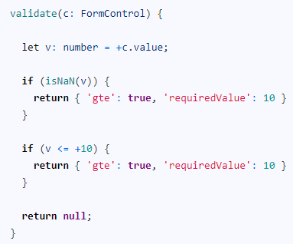
Angular - Example Custom Validator in Template Driven Form
The directive class must implement the validate method. The validate method must honor the ValidatorFn Interface.
It is a simple function, which checks if the value is a number and is less than 10. It returns null if it passes all checks.
If Validation fails it returns the ValidationErrors. It is a key-value pair object of type [key: string]: any and it defines the broken rule. The key is the string and should contain the name of the broken rule. The value can be anything, but usually set to true.
We return the following key-value pair when the validation fails

Slide 45
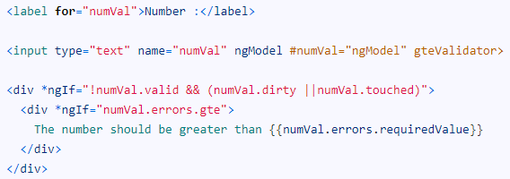
Angular - Example Custom Validator in Template Driven Form
The 'gte': true: indicates that the validation has failed. 'requiredValue': 10 is used by the template to display that the expected value is greater than 10.
Using the Custom Validator
Since this is a template-driven form., we do not have to do anything in the component class. In the HTML template just add the attribute gteValidator as shown below

Slide 46

Angular - Example Custom Validator in Template Driven Form
Validators return ValidationErrors. They are added to the control’s errors collection of the control. The valid property of the control is set to false.
Hence, we check if the valid property. We also check the dirty and touched property. Because we do not want to display the error message when the form is displayed for the first time.
We check if the gte is true and display the error message. Note that gte is the name of the key we used while creating the validator.
We also make use of requiredValue to show a meaningful message to the user.

Slide 47

Angular - Example Custom Validator in Template Driven Form
Passing Parameter to Validator
We have hardcoded the value of 10 in the above example. This will make our validator difficult to reuse. If we want to resue it, we need to pass the number to be checked as the parameter.
Since they are directives, we can use Input decorator to pass the parameter to the Validator.
Open the template add the special attribute gteNum="20“.
We can read the gteNum from the template using the Input decorator as shown below.
Now, we can remove the hardcoded value 10 and use the gteNum instead.

Slide 48
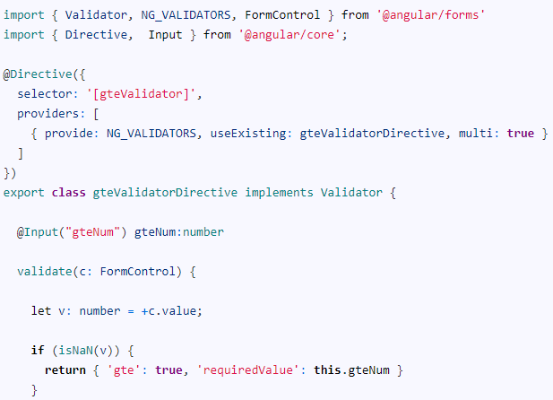
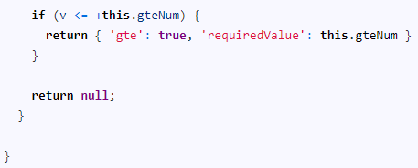
Angular - Example Custom Validator in Template Driven Form
The complete validator code is as shown below.

Slide 49
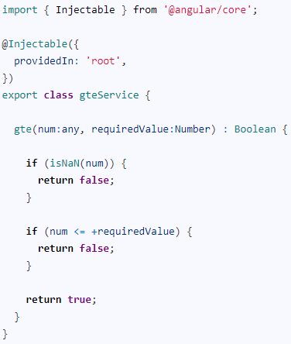
Angular - Example Custom Validator in Template Driven Form
Injecting Service into Validator
The validator may depend on some external service to validate the value. For Example, it may need to fetch data from the back-end server.
Let us move the validation logic in the above validator to a separate service. Create a service gte.service.ts

Slide 50
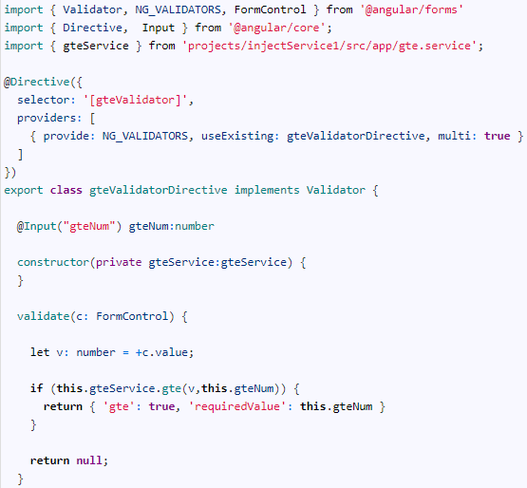
Angular - Example Custom Validator in Template Driven Form
In the validation directive, create a constructor method and inject the service. The complete code is as shown below

Slide 51
Thank You

